Slide 1
Loan Prediction
System
AP21110010935 P.Dheeraj
AP21110010945 P.Sai Akash
AP21110010956 T.Lokesh
http://www.free-powerpoint-templates-design.com

Slide 2

Agenda
01
Introduction
02
Problem Statement
03
Project Objective
04
Hardware and Software requirements

Slide 3
Agenda
05
Proposed Work
06
Machine models
07
Results
08
Advantages & conclusion

Slide 4
Introduction

Slide 5

Introduction
Loans are the core business of banks. The main profit comes directly from the loan's interest. The loan companies grant a loan after an intensive process of verification and validation. However, they still don't have assurance if the applicant can repay the loan with no difficulties. In our Project, we built a predictive model to predict if an applicant is eligible for the loan or not. We prepared a model to predict the target variable. And made a User Interface.

Slide 6
Problem Statement

Slide 7
Problem Statement
Problem Statement
1) Intensive time Consumption process of verification and validation.
2) Human errors can be introduced during the validation process.
3) No cross referencing previous loan records
4) Lot of human resource required.
Problem Solution
1) Our Machine learning model calculates all the parameters given and predicts if the applicant is eligible for loan or not in very less time.
2) Time required for verification, and validation reduces significantly.

Slide 8
Objective

Slide 9
Objective
• To make the process of loan approval easy using fewer resources and human resources.
• To make the User Interface which can be accessible by anyone
• To make the prediction model which will make the accurate predictions and help banks to make approving the loans very easy.

Slide 10
Proposed Work

Slide 11
Proposed Work
Data Collection –Reading the data from the dataset.
Data Cleaning - Cleaning the Data of any null values, if present.
Encoding – Categorical columns translated to Numerical columns.
Analyzing Data – Analyzing the data with various visualization tools.
Model Building- After analyzing and cleaning the data we can build ML models.
Evaluating Performance Metrics of Models- Evaluating which ML model works best & tuning it.
Saving the Model- Saving the model for further integration.
User Interface- Incorporation of model in User Interface.

Slide 12
Hardware and software used
Hardware Used
Os : Windows
Core I5 processor
Software/code editor
Used:
Jupiter Notebook
VS Code
Libraries Used:
Pandas
Numpy
Seaborn
Matplotlib
Sklearn
Joblib
Tikinter

Slide 13
Machine learning Models

Slide 14
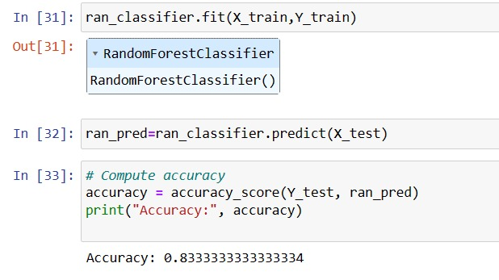

Machine learning Models
Random Forest

Slide 15
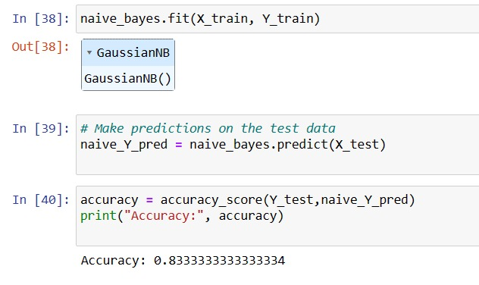
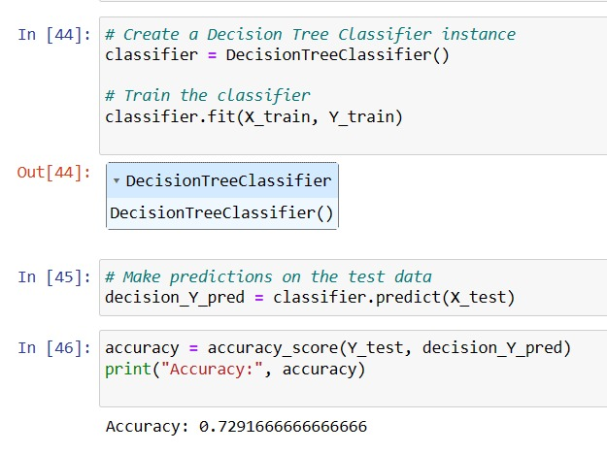
Machine learning models
Navie-bayes
Decision Tree

Slide 16
Results

Slide 17
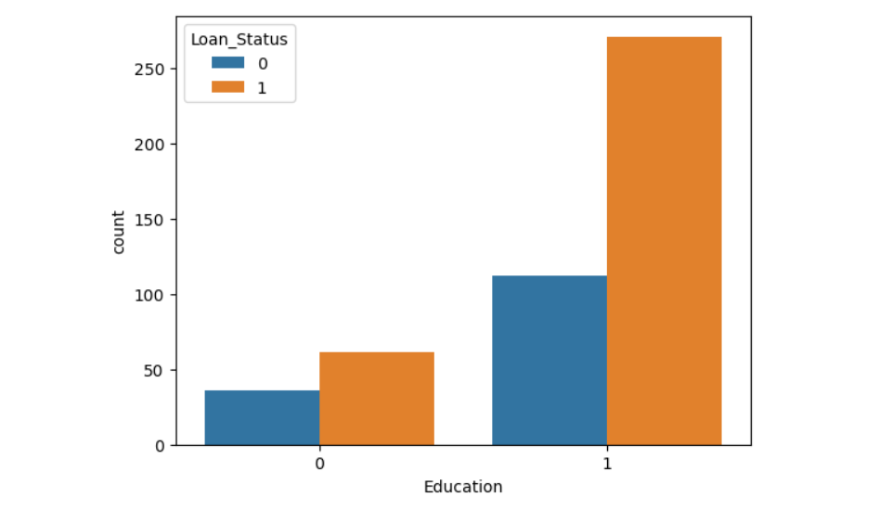
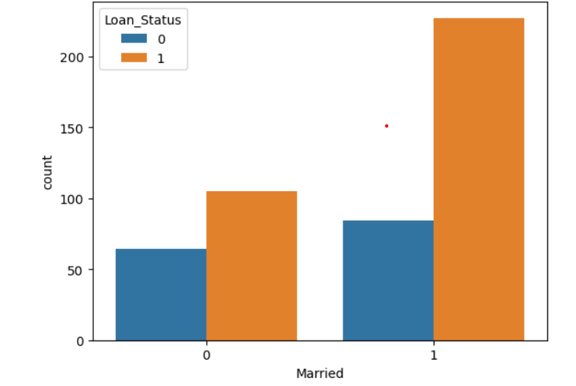
Loan status and Education
Loan status and Marriage

Slide 18
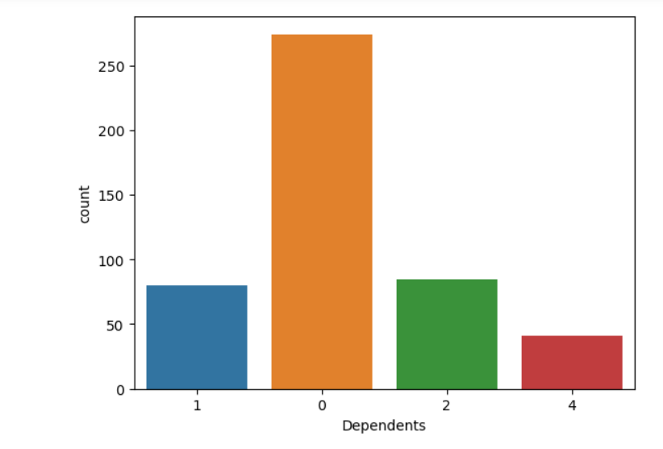
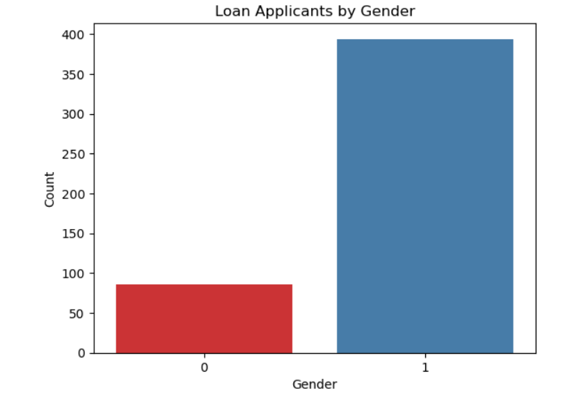

Slide 19
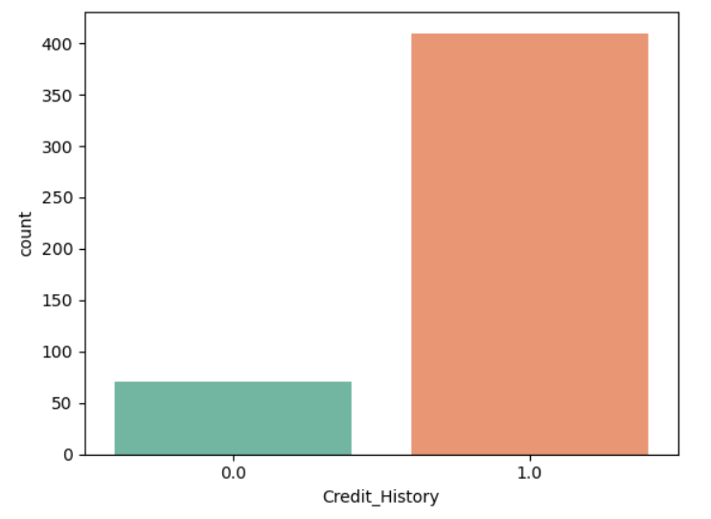
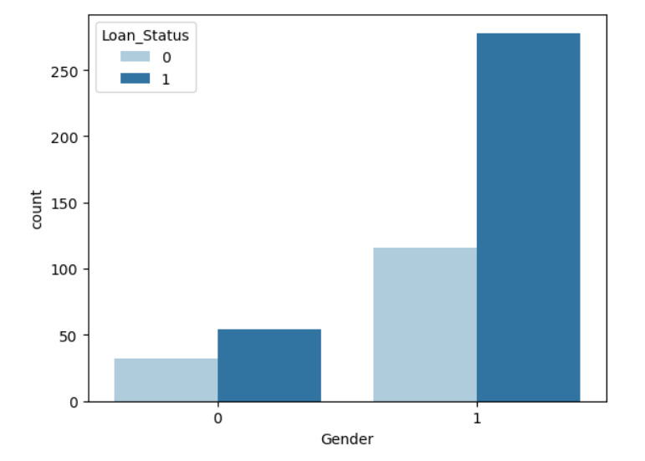

Slide 20
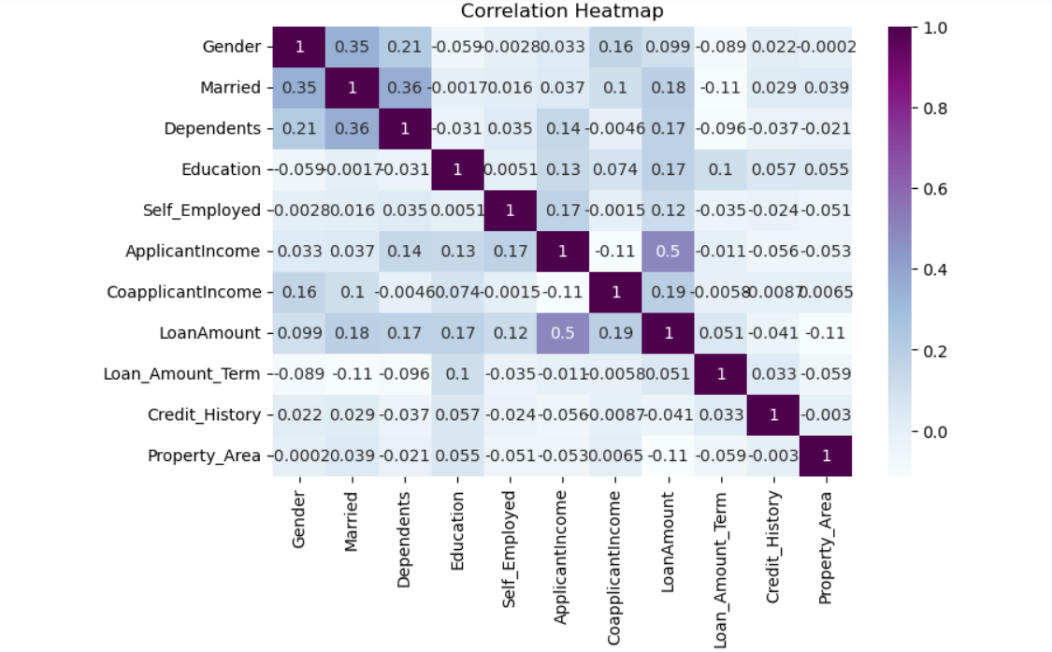

Slide 21
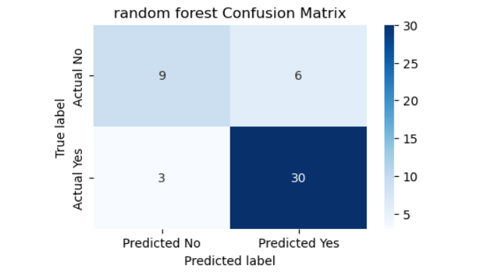
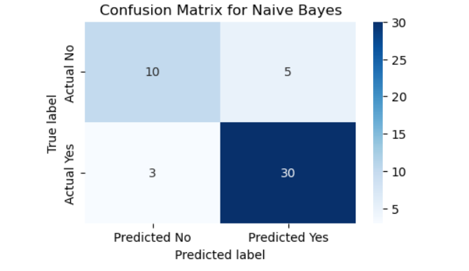
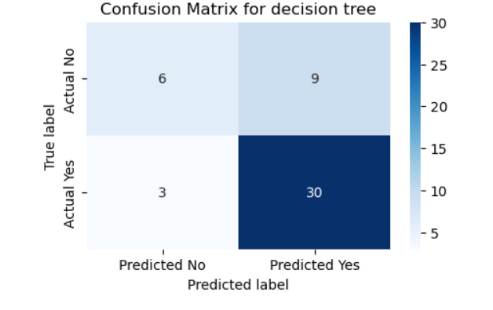

Slide 22
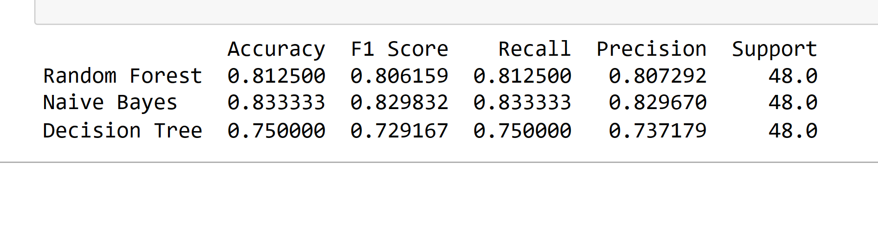
Classification Report

Slide 23
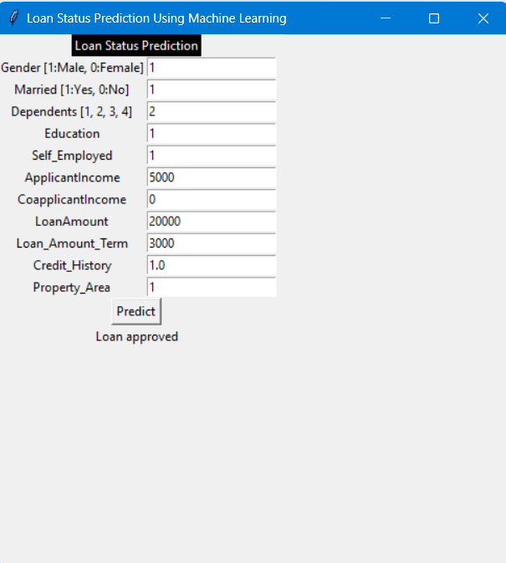
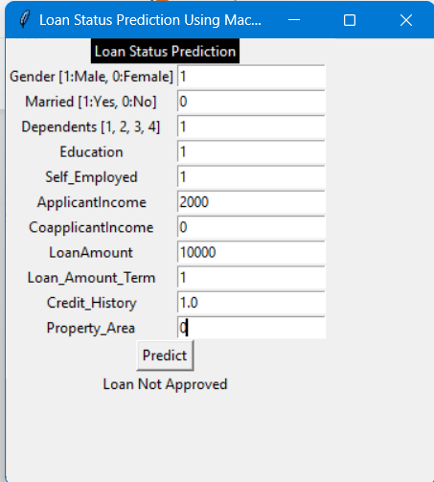

Slide 24
Advantages& Conclusion

Slide 25
Advantages
There have been number of cases of input glitches, Human errors in content while filling it manually while in automated prediction system is more secure, reliable.
The complexity of filing loan in banks will become much easier as a applicant will knew how much amount of loan he is viable.
Machine learning increase the accuracy compare to old traditional system and results get displayed in polar format (yes or no).

Slide 26

Conclusion
The system approved or rejects the loan applications. Recovery of loans is a major contributing parameter in the financial statements of a bank. It is very difficult to predict the possibility of payment of loan by the customer. Machine Learning (ML) techniques are very useful in predicting outcomes for large amount of data. In our project, three machine learning algorithms, Navie Bayes(NB), Decision Tree (DT) and Random Forest (RF) are applied to predict the loan approval of customers. The experimental results conclude that the accuracy of Random Forest machine algorithm is better than compared to decision tree machine learning approaches.

Slide 27
Thank you

